Slide 1
Introduction to Inflation Reduction Act of 2022 (IRA)

Slide 2
What is the Inflation Reduction Act (IRA)?
A budget reconciliation measure
Contains eight titles that address directly or indirectly climate change issues including reduction of U.S greenhouse gas emissions or promotion of adaption and resilience to the impacts of the climate change
Its scope is to reduce U.S GHG emissions by 32% to 40% by 2030
Consists of three sets of measures: a tax reform, a healthcare reform, and energy and climate legislation, including climate-related spending in the order of $400 billion over 10 years

Slide 4
Which Are the Titles and Why Are They Important?
Title I- Committee on Finance
Clean and renewable resources, alternative fuels, energy efficiency, advanced energy manufacturing
Title II-Committee on Agriculture, Nutrition and Forestry
Agriculture, forestry, land conservation
Title III-Committee on Banking, Housing and Urban Affairs
Materials and goods for the national defence, projects for energy or water efficiency of affordable housing
Title IV-Committee on Commerce, Science, and Transportation
Coastal communities, weather research and forecasting, aviation fuels, low-emission aviation technologies

Slide 5
Which Are the Titles and Why Are They Important? (contin.)
Title V- Committee on Energy and Natural Resources
Energy rebates, building codes, energy efficiency, energy infrastructure, technical assistance to Insular Areas
Title VI-Committee on Environmental and Public Works
Funding to the Environmental Protection Agency (EPA), renewable fuels programs, environmental and climate justice block grants,
Title VII-Committee on Homeland Security and Government Affairs
Funding for several environmental programs
Title VIII-Committee on Indian Affairs
Funding for the Bureau of Indian Affairs (BIA) and the Office of Native Hawaiian Relations for climate resilience and adaption programs

Slide 6
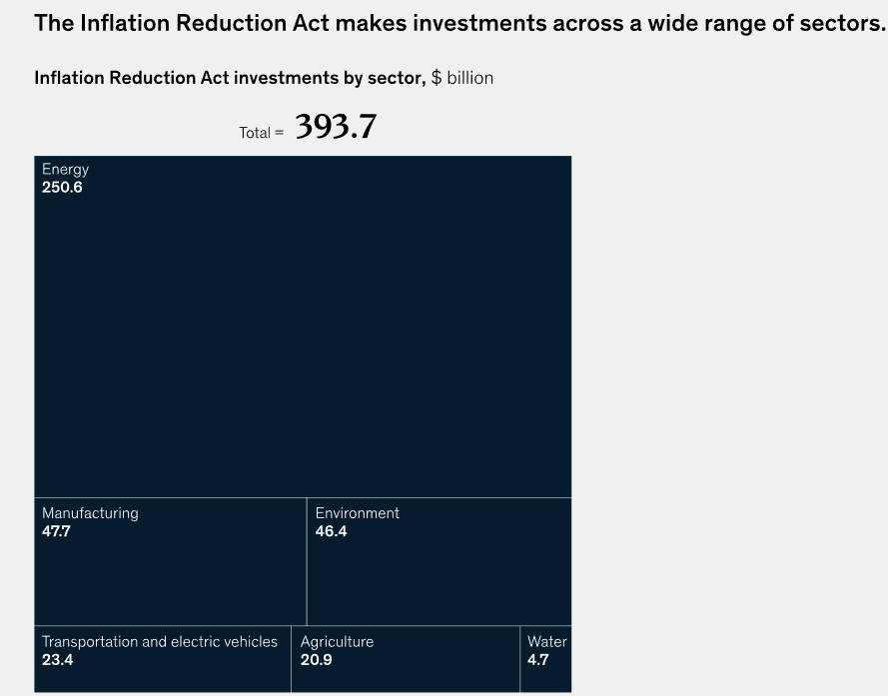
Significant federal funding for climate efforts
Source: Inflation Reduction Act of 2022, H.R 5376, 117th Cong. (2021-2022); McKinsey analysis

Slide 7
IRA funds will flow through more than a dozen federal agencies
Source: Source: Inflation Reduction Act of 2022, H.R 5376, 117th Cong. (2021-2022); McKinsey analysis

Slide 8
How the Inflation Reduction Act Will Help Small Enterprises?
Lowering costs for small businesses:
Preserving critical support for small business health care costs
Cutting energy costs for small businesses
Lowering the deficit to fight inflation and ensure price stability
Lower prescription drug costs for seniors
Expanding economic opportunities for small businesses:
Doubling the Research and Development (R&D) Tax Credit for small businesses
Boosting American manufacturing and competitiveness
Supporting local clean energy economies
Expanding rural opportunities
Leveling the playing field by reforming the tax code

Slide 9
Current Investments under IRA:
Norwegian FREYR has selected and purchased a site in Coweta County, Georgia for multi-phase Giga America clean battery manufacturing project.
German carmaker Volkswagen announced it would invest at least $7.1 billion in North America and launch 25 new electric vehicles by 2030.

Slide 10
One Year Later: Where IRA stands?
Economic Impact and Job Creation
Climate Goals and Clean Energy Growth
Over $110 billion in clean energy manufacturing investments, creating 160.000+ clean energy jobs in just one year.
Estimates project 1.5 million additional until 2033 due to clean energy and climate provisions.
Increased private sector investments, particularly in electric vehicles (EV) and solar manufacturing, totaling approximately $240 billion since President Biden’s election in November 2020.
Expected to reduce greenhouse gas emissions by approximately 1 billion tons by 2030.
Greenhouse gas emissions will be decreased by up to 41% below 2005 levels by 2030.
Projections indicate a potential increase in clean electricity generation, targeting 80% clean electricity by 2030.
Anticipated tripling of wind energy and seven- to eight- fold increase in solar generation by 2030.
Electric Vehicles sales tripled since the introduction of IRA, supported by Act’s clean energy manufacturing investments.

Slide 11
One Year Later: Where IRA stands?
Community Resilience and Environmental Justice
Energy Affordability and Health Care
Billions allocated to protect communities from climate change impacts, enhance resilience, and reduce environmental hazards.
Focus on equity and environmental justice through grants and initiatives to reduce pollution and enhance community capacity.
Anticipated savings of $27-38 billion on electricity bills between 2022-2030 due to Act’s provisions.
Nearly 15 million people saving on average of $800 per year on health insurance premiums.
Medicare beneficiaries benefit from capped insulin costs at $35 per month, saving senior citizens significant amounts on prescription drugs.

Slide 12
One Year Later: Where IRA stands?
Taxation and IRS improvements
Environmental Protection Agency Incentives
Aims to raise $300 billion over a decade from large corporations through a 15% minimum tax on profits and a 1% excise tax on stock buybacks.
Investments in IRS modernization enhancing services, resulting in improved customer service and tax collection efficiency.
EPA’s $350 million investment to reduce emissions from construction materials though grants and technical assistance.
Collaboration with stakeholders to measure and lower carbon emissions associated with construction materials, aiming for a more sustainable marketplace.

Slide 13
Bibliography
Inflation Reduction Act Guidebook: https://www.whitehouse.gov/cleanenergy/inflation-reduction-act-guidebook/
How the Inflation Reduction Act Will Help Small Businesses:
https://www.whitehouse.gov/briefing-room/statements-releases/2022/09/12/fact-sheet-how-the-inflation-reduction-act-will-help-small-businesses/
The Full Press Release for FREYR: https://ir.freyrbattery.com/ir-news/press-releases/news-details/2022/FREYR-Battery-Announces-Plans-for-U.S.-Gigafactory-in-Georgia/default.aspx
The Full Press Release for Volkswagen: https://media.vw.com/en-us/releases/1668

Slide 14
Bibliography
One year later: The Inflation Reduction Act and climate progress | Brookings
FACT SHEET: One Year In, President Biden’s Inflation Reduction Act is Driving Historic Climate Action and Investing in America to Create Good Paying Jobs and Reduce Costs

