Slide 1

CHIPS Incentives Program – Commercial Fabrication Facilities

Slide 2
Introduction
Semiconductors, or chips, are tiny electronic components that are essential to America’s economic and national security
Power our consumer electronics, automobiles, data centers, critical infrastructure, and virtually all military systems
The U.S remains a global leader in semiconductor design and research and development, yet it only holds 10% of the global commercial production
The law provides the Department of Commerce with $50 billion for various programs to:
    strengthen and secure the U.S position in semiconductor research, development, and manufacturing
    while also focusing on American workers.

Slide 3
Introduction
The CHIPS Act encompasses two offices responsible for implementing the law:
    i) the CHIPS Research and Development Office is investing $11 billion into developing a robust domestic R&D ecosystem,
    Ii) while the CHIPS Program Office is dedicating $39 billion to provide incentives for investment in facilities and equipment in the United States,
    The current funding incentive is open to applications from semiconductor manufacturers and producers of semiconductor materials and equipment that want to build, renovate, or expand U.S. semiconductor facilities. Foreign organizations may apply, but funds must be utilized in the United States only.

Slide 4
Which Are the Funding Opportunities?
1st Notice of Funding Opportunity (current):
  For commercial leading edge, current, and mature node fabrication activities
  As of June 23, 2023, the current funding announcement has been expanded to also seek applications for the construction, expansion, or modernization of commercial facilities for semiconductor materials and manufacturing equipment facilities for which the capital investment equals or exceeds $300 million.
    Note: For current and future funding opportunities, a statement of interest is strongly encouraged to be submitted through the portal, three weeks prior to the submission of the full application

Slide 5
Which Are the Funding Instruments?
Direct Funding:
  Provide funding for eligible costs. It can take the form of grants, cooperative agreements, other transaction agreements. The amounts available are up to $38.22 billion
Direct Loans and Loan Guarantees:
  The amounts available are up to $75 billion in direct loan or guaranteed principal
  Note: The Department will not award the full amounts available under this funding notice as future funding calls are expected to open

Slide 6
Vision for Success: Which are the Parameters?
Leading-edge logic
Advanced packaging
By the end of the decade, the U.S will have at least two new large-scale clusters of leading-edge logic fabs
U.S-based engineers will develop the next gen of logic chips
The U.S will host multiple high-volume advanced packaging facilities
Strengthen U.S leadership position in commercial-scale advanced packaging technology

Slide 7
Vision for Success (cont.)
Memory
Current-generation and mature
U.S-based fabs will produce high-volume memory chips on economically competitive terms
Strong focus on R&D for next-generation memory technologies that will be conducted in the U.S
The U.S will acquire strategically increased its production capacity for current-gen and mature chips
Chip producers will response more nimbly to future supply and demand shocks

Slide 8
Program Priorities
Economic and National Security Objectives
Commercial viability
Increase U.S semiconductor production and align with U.S strategic needs
Create a more resilient semiconductor supply chain
Contribute to a self-sustaining ecosystem and catalyze future upgrades
Demand for the product
Existing and planned supply
Stability and predictability of key suppliers

Slide 9
Program Priorities
FINANCIAL STRENGTH
Project technical feasibility and readiness
Financial strength and sustainability of the project
Commitment of private/third-party investment
Comprehensiveness and reasonableness of the CHIPS funding request
Organizational readiness
Clear project execution plan
Compliance to environmental requirements

Slide 10
Program Priorities
Workforce development
BROADER IMPACTS
A highly skilled, diverse workforce is essential:
  Ability to recruit, train, hire, retain and upskill a diverse workforce in good jobs
Include women/ disadvantaged communities
Engage with local partners
Child care
Commitments to future investment
Support for semiconductor R&D
Inclusive opportunities for businesses
Climate and environmental responsibility
Upside sharing

Slide 11
How Small Businesses Will Benefit from the CHIPS Act?
In addition to strengthening semiconductor production, the CHIPS Act will impact a wide range of industries by:
Revitalizing local economies
    By creating tech hubs around the country, the Act promises to have a positive knock-on effect on all businesses
Securing supply chain gaps
    By focusing on increasing domestic production
Building a strong and diverse workforce
    By funding STEM programs for schools, colleges, and universities that will train the next generation of technicians needed by regional semiconductor companies

Slide 12
What Are Some of the Investments?
Micron Technology, Inc., one of the world’s largest semiconductor companies, announced $40 billion investment in leading-edge memory manufacturing in the United States.
Qualcomm and GlobalFoundries announced a partnership that includes a $4.2 billion to manufacture chips in an expansion of GlobalFoundries’ upstate New York facility.
Wolfspeed announced it will build the world’s largest silicon carbide semiconductor plant in Chatham Country, North Carolina.

Slide 13
Application Process
Required documents
Submission dates
Statement of interest
Recommended pre-application
Full application
Due diligence
Award preparation and insurance
Pre-applications and full-applications are assessed on a rolling basis and applicants receive feedback at various stages
Applications for leading-edge facilities:
    Friday 31st March, 2023 (pre and full)
Applications for current generation, mature-node, and back-end production facilities:
    Monday 1st May 2023 (Pre) &
    Monday 26th June 2023 (Full)
Applications for wafer manufacturing facilities:
    Friday 1st September 2023 (Pre) &
    Monday 23rd October 2023 (Full)
Applications for semi-conductor materials and manufacturing equipment facilities (capital exceeds $300 million)
    Friday 1st September 2023 (Pre) &
    Monday 23rd October 2023 (Full)

Slide 14
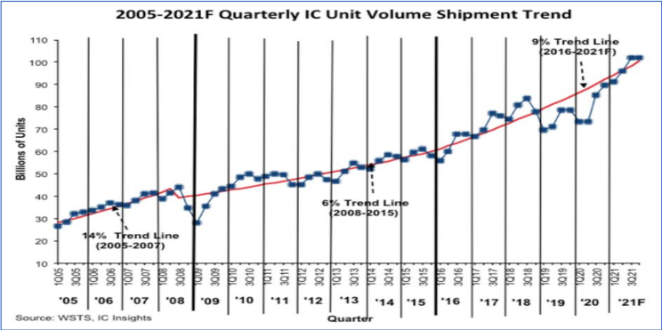
From the onset of the COVID-19 pandemic in early 2020, the entire semiconductor business has seen a strong growth in demand. Shipments of chips increased by 40% from around 73 billion in 1Q20 to approximately 102 billion in 3Q21

Slide 15
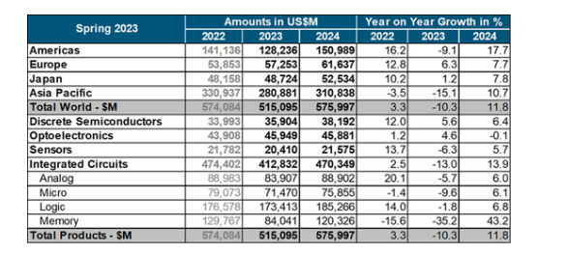
Forecast Summary Spring 2023

Slide 16
Latest Updates (November 2023)
SemiUS, a newly formed consortium, is set to oversee the National Semiconductor Technology Center (NSTC) as part of the CHIPS for America program, aiming to revolutionize semiconductor R&D and collaboration within the industry.
NSTC's mission is to accelerate innovation, reduce time-to-market, and reduce costs for emerging technologies within the semiconductor manufacturing and supplier ecosystem.
NSTC has recently appointed new Board members who will lead the nonprofit entity, working in alignment with the Department of Commerce's funding agreement to enable the Center’s operations.
Secretary of Commerce Gina Raimondo has emphasized the NSTC's crucial role in revitalizing U.S. semiconductor manufacturing, ensuring technological leadership, and boosting global competitiveness.

Slide 17
Latest Updates (November 2023)
SemiUS plans to commence operations in 2024, focusing on hiring leadership, establishing membership structures, and collaborating closely with governmental agencies to meet NSTC's mission.
The Department of Commerce aims to invest approximately $3 billion in the National Advanced Packaging Manufacturing Program (NAPMP) to bolster the U.S.'s advanced packaging capabilities for semiconductor manufacturing.
NAPMP aims to drive leadership in materials, equipment, workforce training, and various technological areas crucial for semiconductor innovation, positioning the U.S. as a leader in manufacturing and packaging all kinds of chips.
Through NAPMP and NSTC initiatives, CHIPS for America aims to creating an innovation-driven environment to attract semiconductor manufacturers to invest in the U.S., thereby enhancing domestic technological capabilities.

Slide 18
Bibliography
The Notice of Funding Opportunity: Commercial Fabrication is available on chips.gov
The Full Press Release for Micron Technology: https://investors.micron.com/news-releases/news-release-details/micron-announces-40-billion-investment-leading-edge-memory
The Full Press Release for Qualcomm and GlobalFoundries: https://www.qualcomm.com/news/releases/2022/08/globalfoundries-and-qualcomm-announce-extension-of-long-term-agr
The Full Press Release on Wolfspreed: https://www.wolfspeed.com/company/news-events/news/wolfspeed-selects-north-carolina-for-worlds-largest-silicon-carbide-materials-facility/

Slide 19
Bibliography
CHIPS for America Releases Vision for Approximately $3 Billion National Advanced Packaging Manufacturing Program: CHIPS for America Releases Vision for Approximately $3 Billion National Advanced Packaging Manufacturing Program | NIST
Department of Commerce Reaches Agreement with New Organization, SemiUS, to Operate National Semiconductor Technology Center (NSTC) Once Established: Department of Commerce Reaches Agreement with New Organization, SemiUS, to Operate National Semiconductor Technology Center (NSTC) Once Established | NIST
How the CHIPS Act is aiming to restore a U.S. lead position in semiconductors: How the CHIPS Act is aiming to restore a U.S. lead in semiconductors (cnbc.com)

