Slide 1
E-invoicing as a tool to combat tax evasion
The Portuguese Experience
Paulo Núncio 16.04.2019

Slide 2

E-invoicing as a tool to combat tax evasion – The Portuguese Experience
Reform background: 2011
  Public Deficit: 11,3%
  Public Debt: 111,4% of GDP
  External Deficit: 10%
  Adjustment programe: 2011-2014
      Fiscal Consolidation
        Tackling Tax Fraud
          E-INVOICING REFORM
Source: http://www.sisnetwork.eu/about/success-stories/

Slide 3

E-INVOICING REFORM
01.

Slide 4

E-invoicing as a tool to combat tax evasion – The Portuguese Experience
1. European cONTEXT
European efforts to fight tax fraud and evasion
Green paper made by European Commission
COM issues a report (Dec 2010) on the future of VAT
All 4 alternative models have a positive cost-benefit ratio, altough the cost of implementation of the methods varies
Models | 1 Split payment model | 2 Data warehouse model | 3 Certified taxable person model | 4 Central monitoring database model
 | Bank splits the payment The taxable amount is paid to the supplier The VAT amount transferred directly to the tax authority | Company uploads predefined transaction data into a secure VAT data warehouse Company maintains the database and accessible to the tax authority | VAT compliance process and internal controls are certified | Invoice data is sent in real time to a central VAT monitoring database

Slide 5

E-invoicing as a tool to combat tax evasion – The Portuguese Experience
2. Portuguese E-invoicing REFORM
Model 2 – Implementation of the Standard Auditing File System
Model 3 – Certified invoicing software
Model 4 – Central VAT monitoring database
Measure
OECD recommendation implemented in 2009
Computer file that allows the easy export accounting records [SAF-T(PT)]
Scope
Corporate income tax (CIT) taxpayers
VAT taxpayers with turnovers above € 100.000
2009
Measure
All invoicing software be previously certified by the tax authorities
Scope
Corporate Income Tax taxpayers
VAT taxpayers with turnovers above € 100.000
2010
Measure
All taxpayers to communicate in real time (or via a monthly export) all invoices issued
Scope
All Corporate Income Tax taxpayers
VAT taxpayers with turnover above € 100.000 send invoice information electronically
2013

Slide 6
E-invoicing as a tool to combat tax evasion – The Portuguese Experience
2. Portuguese E-invoicing REFORM
Four adDitional measures
Mandatory invoices
  All VAT taxable transactions must be documented by an invoice
Tax benefit for requesting invoices
  Invoice issued entitled to a 15% refund of VAT paid against PIT assessed in the following year (up to € 500 per households)
Tax lottery
  Weekly lottery
  Each 10€ entitles a participation coupon
  Prize: Cars / Treasury Bills
Transport electronic documents
  All goods transported must be accompanied by an electronic document
2009
2010
2013

Slide 7
E-invoicing as a tool to combat tax evasion – The Portuguese Experience
TIMELINE
1
SAF-T
Model
VAT Rates Increase
Invoice/Receipt
Issuing
3
e-Invoice launched
Transport documents
Strengthening
the cross referencing system
Companies with computerized accounting required to produce, for audit purposes, the SAF-T (PT) according to the OECD Model
Standard rate inflated
3 bps to 23%.
Several reduced rates increased to the standard (some from 5%)
New web tool, mandatory
for self-employed and for
issuing the Invoices to
their clients, replacing the previous paper receipts
All goods transported must be accompanied by an electronic document
Mandatory submission of invoices for businesses; invoice portal goes live and is center stage
Analysis of the data is on-going and new cross-referencing algorithms are being developed
2008
2009
2010
2011
2012
2013
2014
2015
2016
e-invoice for
individual tax returns
2
Software Certification
Printing-Houses
Lottery
First lottery in April 17, broadcast on national TV; 7.9 million consumers were awarded coupons
Businesses are required to use exclusively invoicing programs which have been subjected to certification by the Taxation and Customs Authority
Support for printing-houses to electronically identify the ranges of paper invoices provided to their customers
All individual income tax deductions are supported by invoices coming through e-invoice

Slide 8

rESULTS
E-invoicing reform
02.

Slide 9

E-invoicing as a tool to combat tax evasion – The Portuguese Experience
KEY ACHIEVEMENTS
INNOVATIVE MODEL IN EUROPE TO CURB SHADOW ECONOMY
COST FOR THE TAX AUTHORITY WAS LOWER THAN EXPECTED
GOOD ACCEPTANCE BY THE BUSINESS COMMUNITY - BUSINESS FRIENDLY SYSTEM
MAJOR CHANGES IN CULTURAL BEHAVIOR
INVOICING CONTROL IN REAL TIME
100,000 COMPANIES WITH INVOICES WITHOUT VAT RETURN
220,000 COMPANIES ASSESSED LESS OR DEDUCTED MORE VAT THAN DUE
528,000 VAT TAXPAYERS WITH IRREGULARITIES – 40% VOLUNTARY REGULARIZATION

Slide 10
E-invoicing as a tool to combat tax evasion – The Portuguese Experience
total INVOICes: 2013-2018
+ 30%
4,4%
5.801.202.546
2018

Slide 11
E-invoicing as a tool to combat tax evasion – The Portuguese Experience
TOTAL b2c INVOICes: 2013-2018
+ 167%
9,1%
1.319.617.398
2018

Slide 12
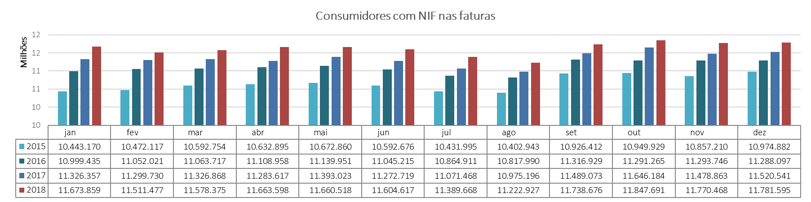
E-invoicing as a tool to combat tax evasion – The Portuguese Experience
Individual consumer’s participation

Slide 13
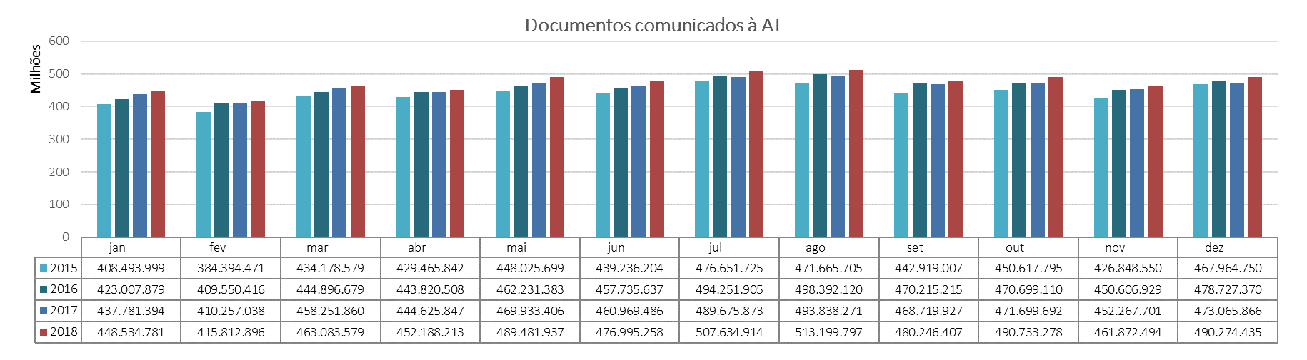
E-invoicing as a tool to combat tax evasion – The Portuguese Experience
Electronic transport documents

Slide 14
E-invoicing as a tool to combat tax evasion – The Portuguese Experience
TOTAL Tax revenues
2011-2019: +37%
+18%
+16%

Slide 15
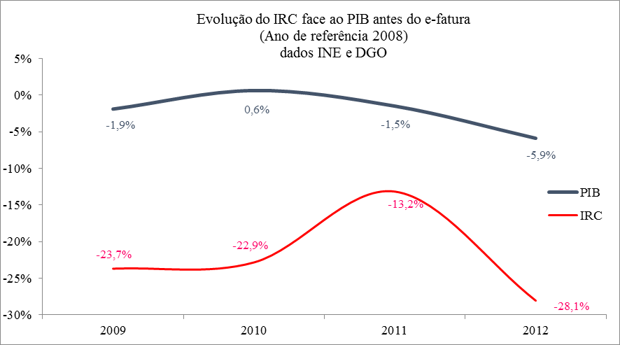
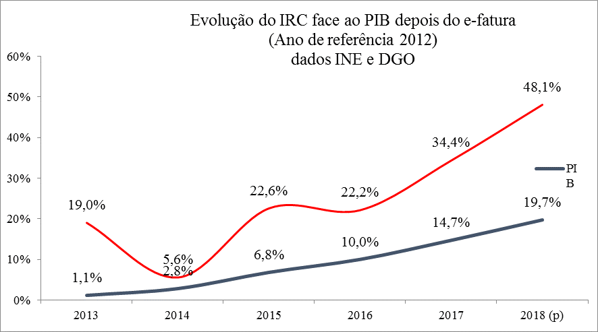
E-invoicing as a tool to combat tax evasion – The Portuguese Experience
Tax revenues: CIT VS. GDP
Before e-invoicing reform
After e-invoicing reform

Slide 16
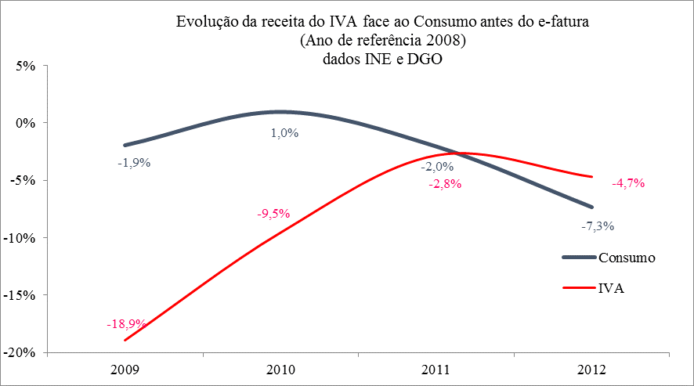
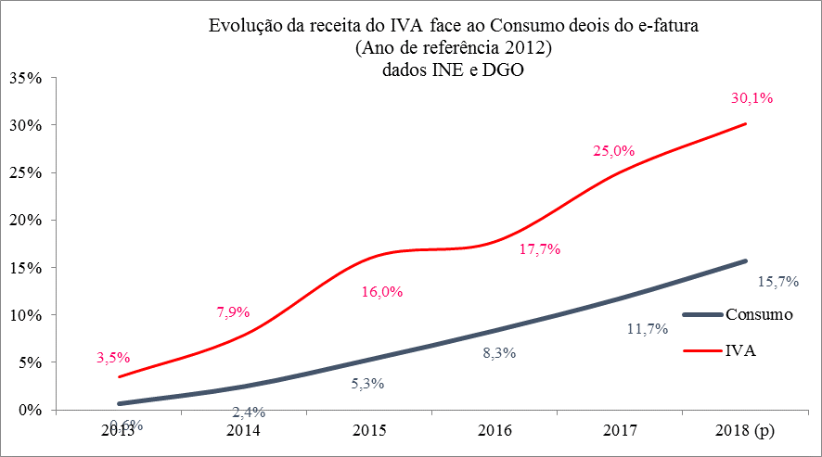
E-invoicing as a tool to combat tax evasion – The Portuguese Experience
Tax revenues: VAT VS. Consumption
Before e-invoicing reform
After e-invoicing reform

Slide 17
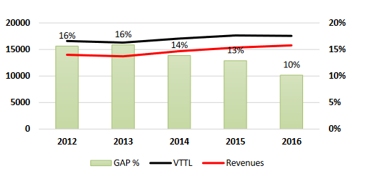
E-invoicing as a tool to combat tax evasion – The Portuguese Experience
PORTUGUESE VAT GAp
Dropped from 16% to 10%

Slide 18
E-invoicing as a tool to combat tax evasion – The Portuguese Experience
Thank you for your
attention

